Slide 1
New Horizon of Quantum Computing
Dibakar Sigdel, PhD

Slide 2
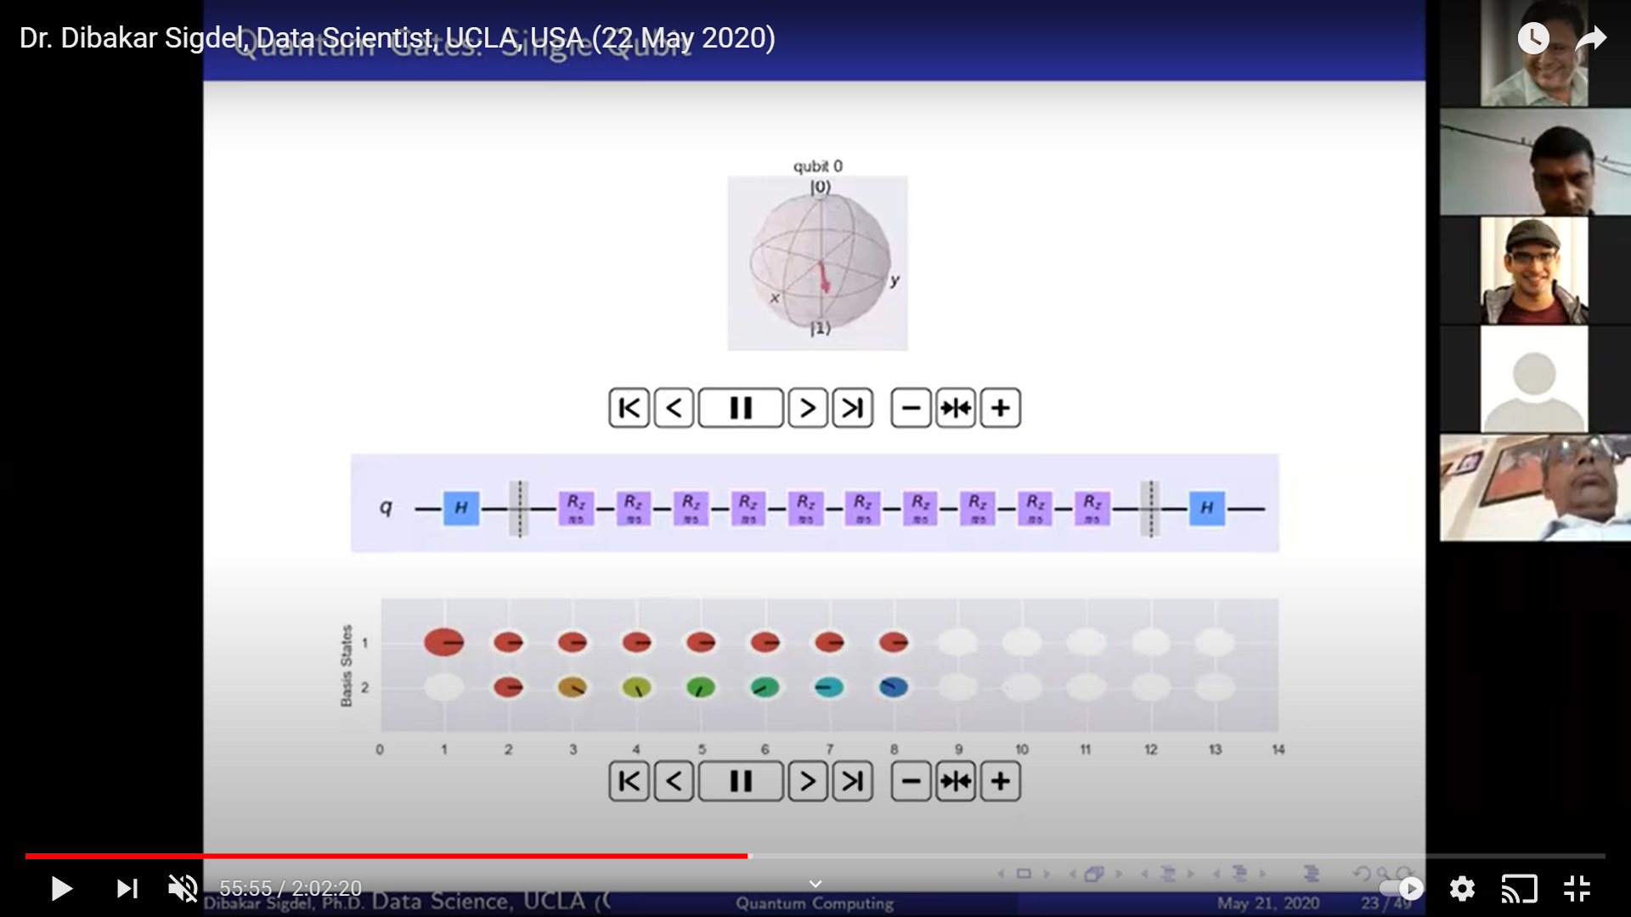
https://www.youtube.com/watch?v=vi0sRjilceY

Slide 3
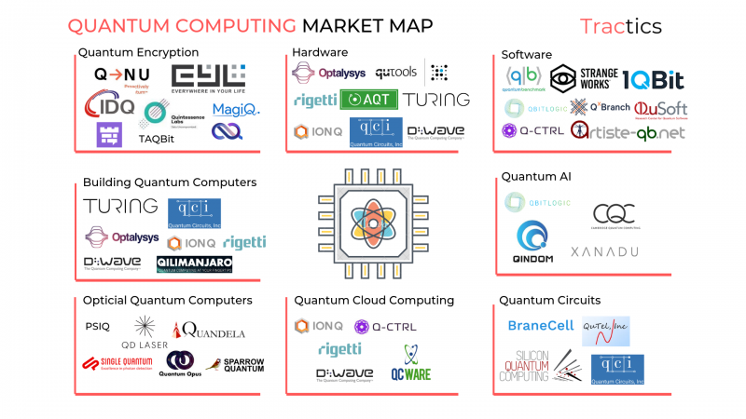
Image : https://research.aimultiple.com

Slide 4
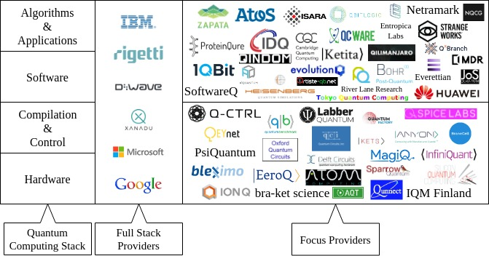
Quantum Computing service in Full Stack Perspective
https://quantumcomputingreport.com

Slide 5
134 Quantum Computing Startups
https://jsfiddle.net/Vasu010/rzg4ow6L/154/show

Slide 6
Quantum Computing Platform

Slide 7
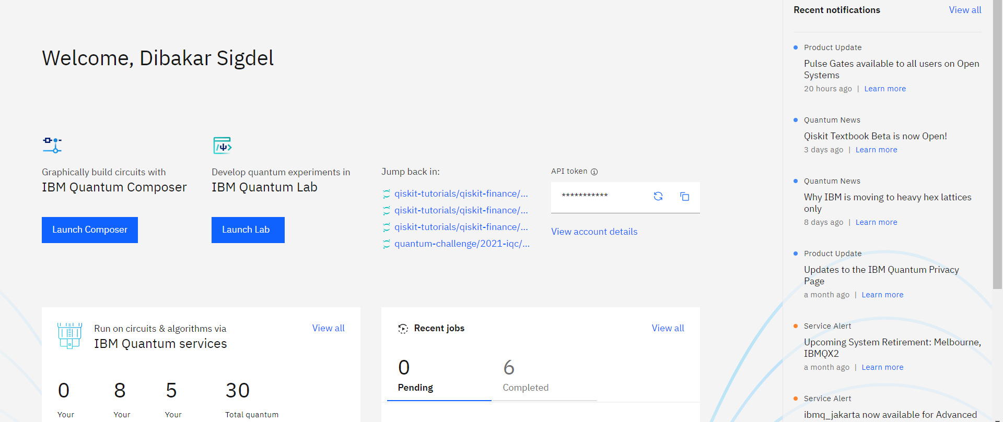
IBM Quantum Experience
https://quantum-computing.ibm.com
QisKit Documentation: https://qiskit.org/documentation
QisKit TextBook: https://qiskit.org/textbook/preface.html
QisKit Community: Create account at IBM Quantum Experience (Slack link is available)

Slide 8
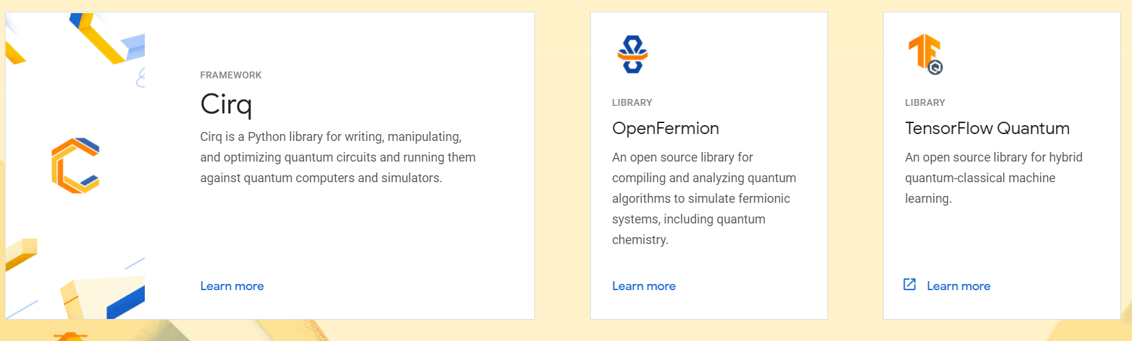
Google Quantum Lab
Source: https://quantumai.google
Cirq Documentation: https://quantumai.google/cirq/start
Cirq Tutorials: https://quantumai.google/cirq/tutorials
Open Fermion Tutorials: https://quantumai.google/openfermion/tutorials/intro_to_openfermion
TensorFlow Quantum Tutorials: https://www.tensorflow.org/quantum/tutorials

Slide 9
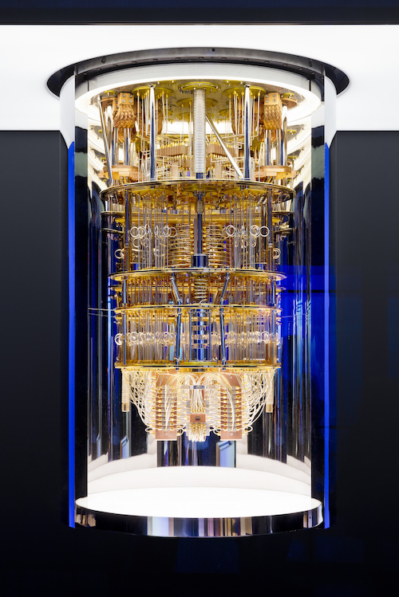
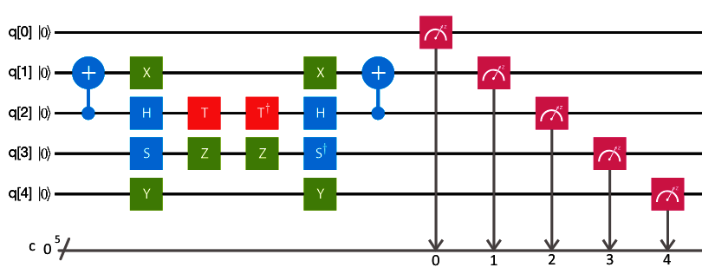
Qubit based Quantum Circuits
QisKit Textbook: https://qiskit.org/textbook/preface.html

Slide 10
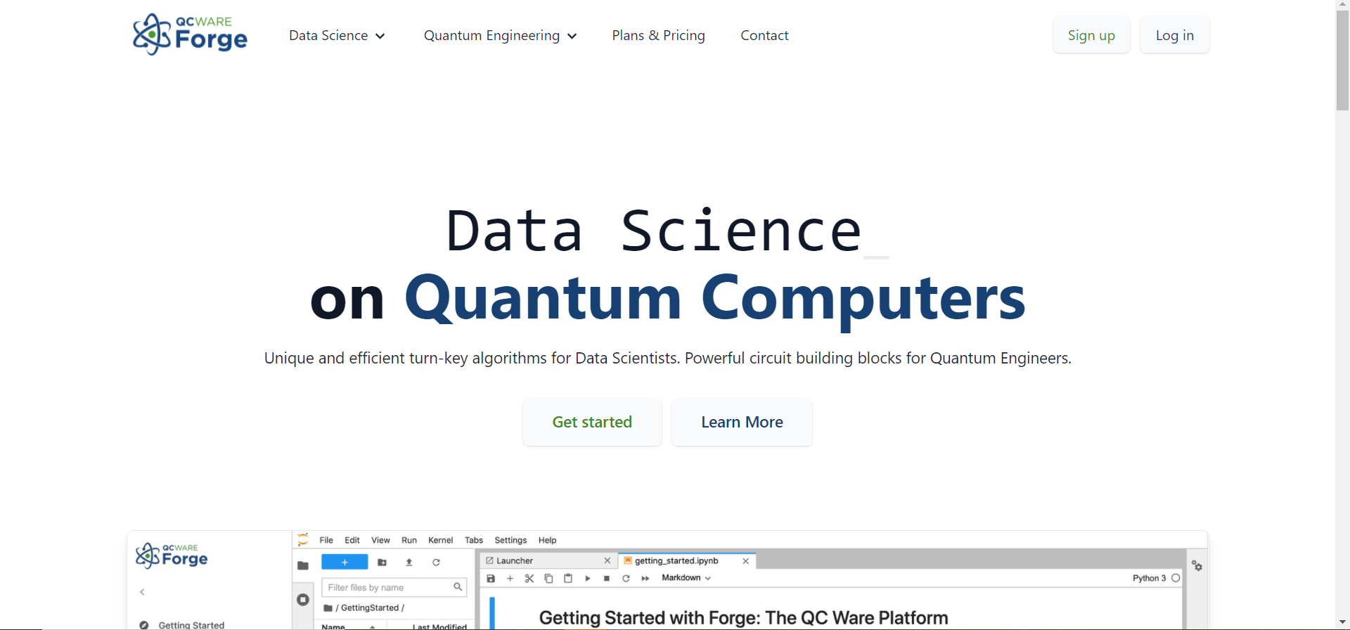
QC WARE FORGE
https://forge.qcware.com
QCWare Documentation: https://qcware.readthedocs.io/en/latest

Slide 11
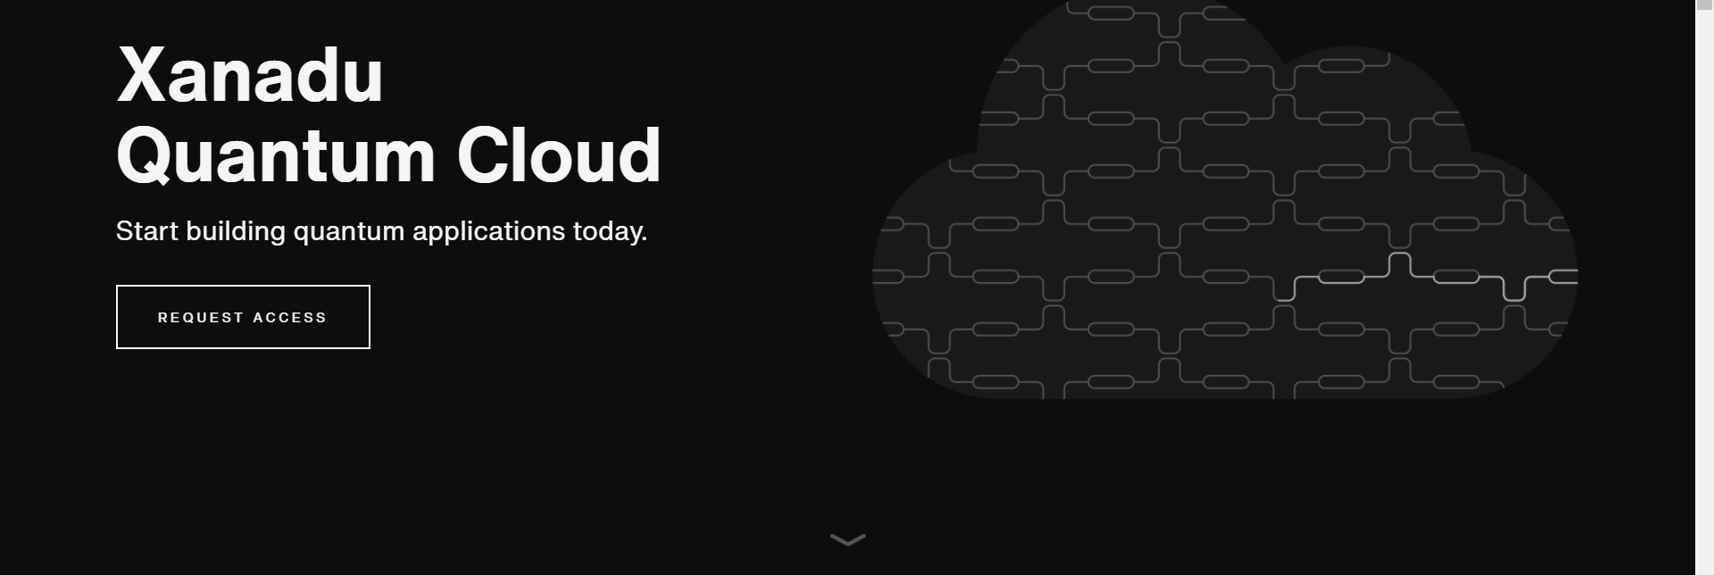
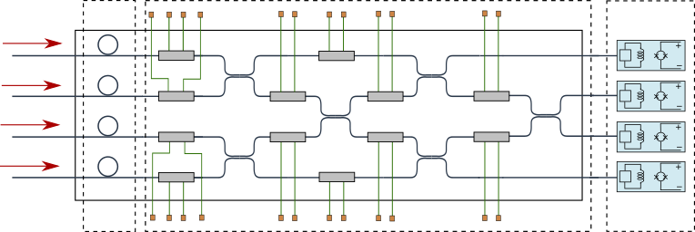
https://pennylane.ai
Strawberry Fields: A cross-platform Python library for simulating and executing programs on quantum photonic hardware.
Strawberry Fields documents: https://strawberryfields.ai
Pennylane : A cross-platform Python library for differentiable programming of quantum computers. Train a quantum computer the same way as a neural network.
Pennylane Documents: https://pennylane.ai

Slide 12
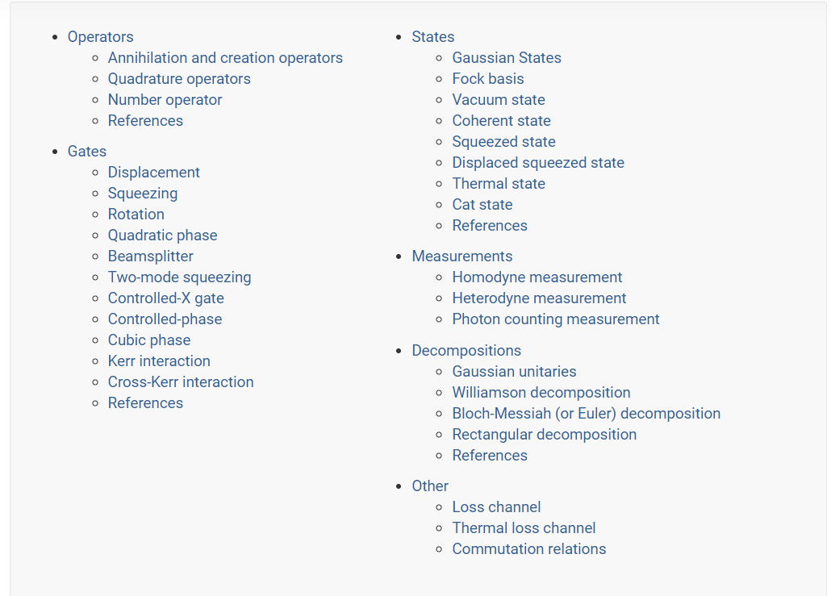
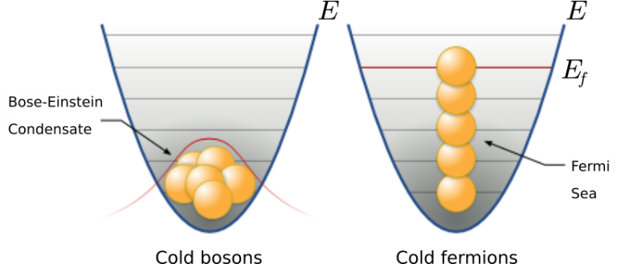
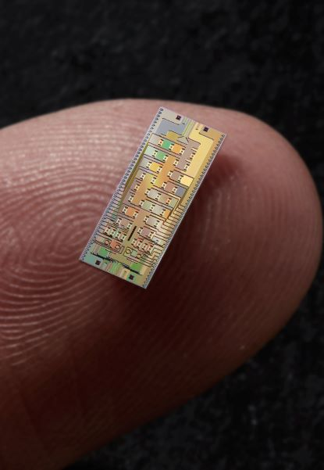
Photon (Qmodes) Based Quantum Circuits
https://strawberryfields.ai/photonics/concepts/index.html source: https://physicsworld.com

Slide 13
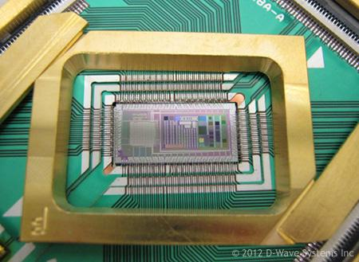
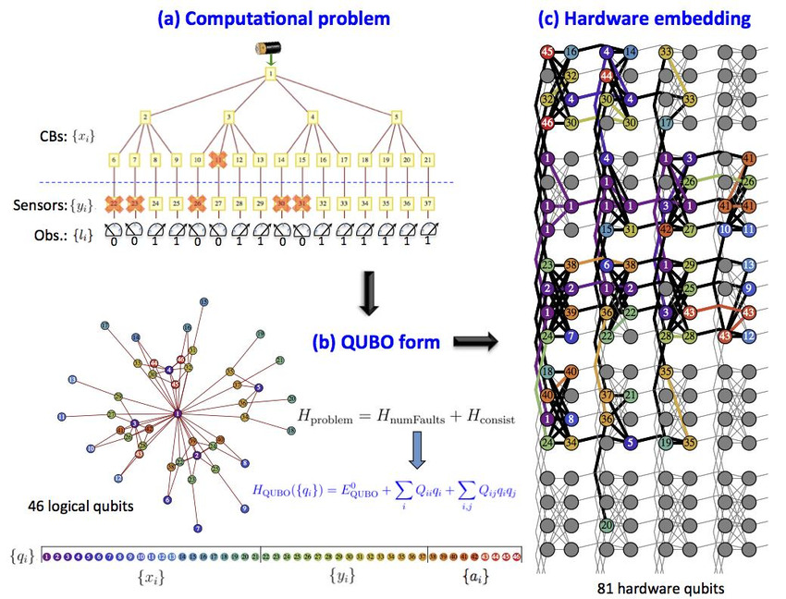
DWave Quantum Computing
Source: Dwave system
Source: Luke Shulenburger et. al.
Dwave Applications: https://www.dwavesys.com/applications
Dwave Documentation: https://docs.dwavesys.com/docs/latest/index.html
Ocean Documentation: https://docs.ocean.dwavesys.com/en/stable

Slide 14
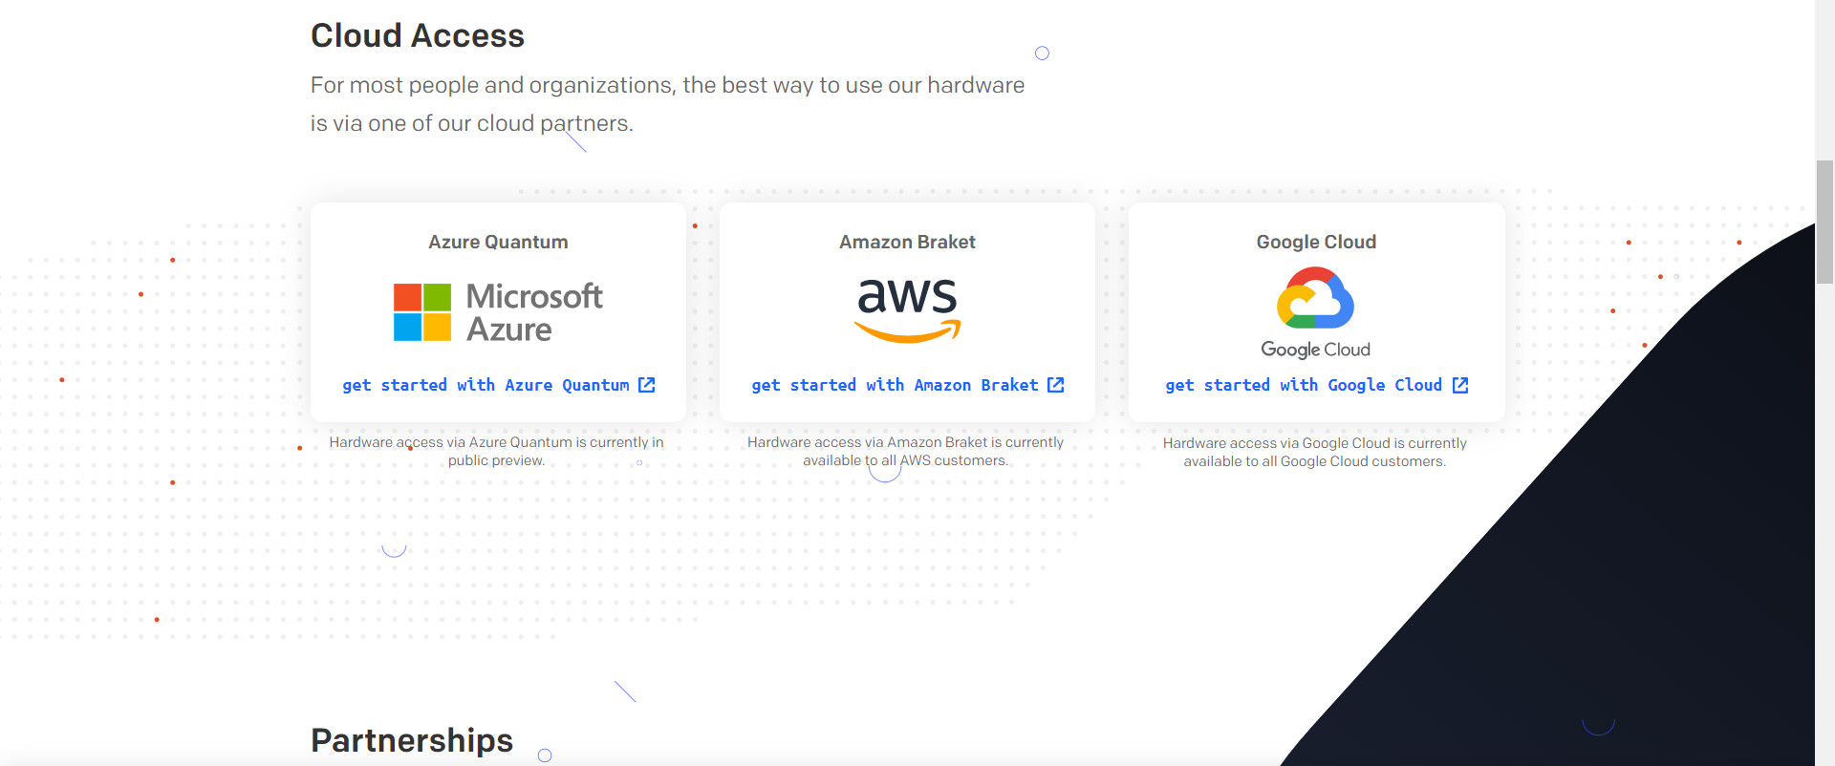
Ion-Q Platform
https://ionq.com/get-started
IonQ Documentation: https://ionq.com/docs

Slide 15
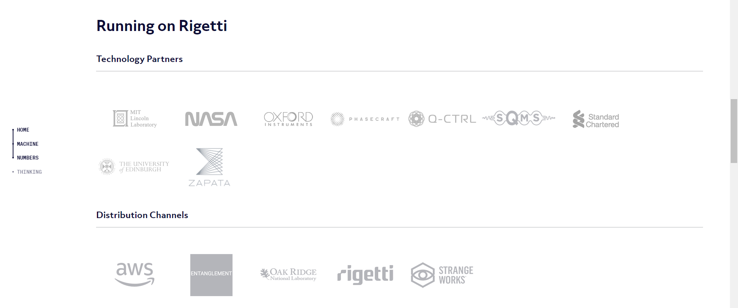
https://www.rigetti.com

Slide 16
Quantum Computing -Sectors

Slide 17
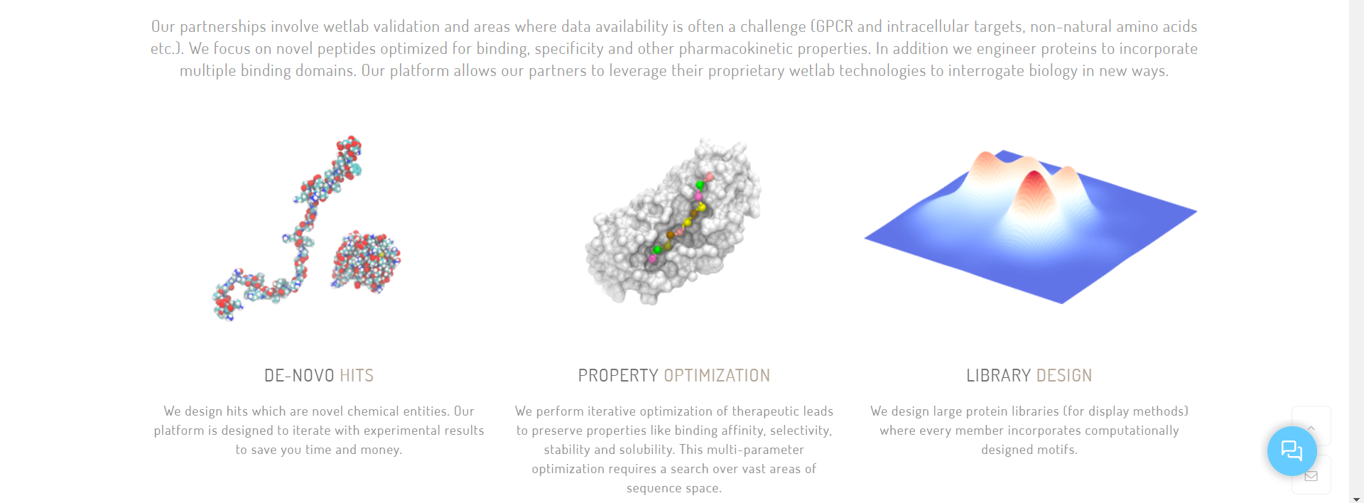
Proteinqure
https://www.proteinqure.com/

Slide 18
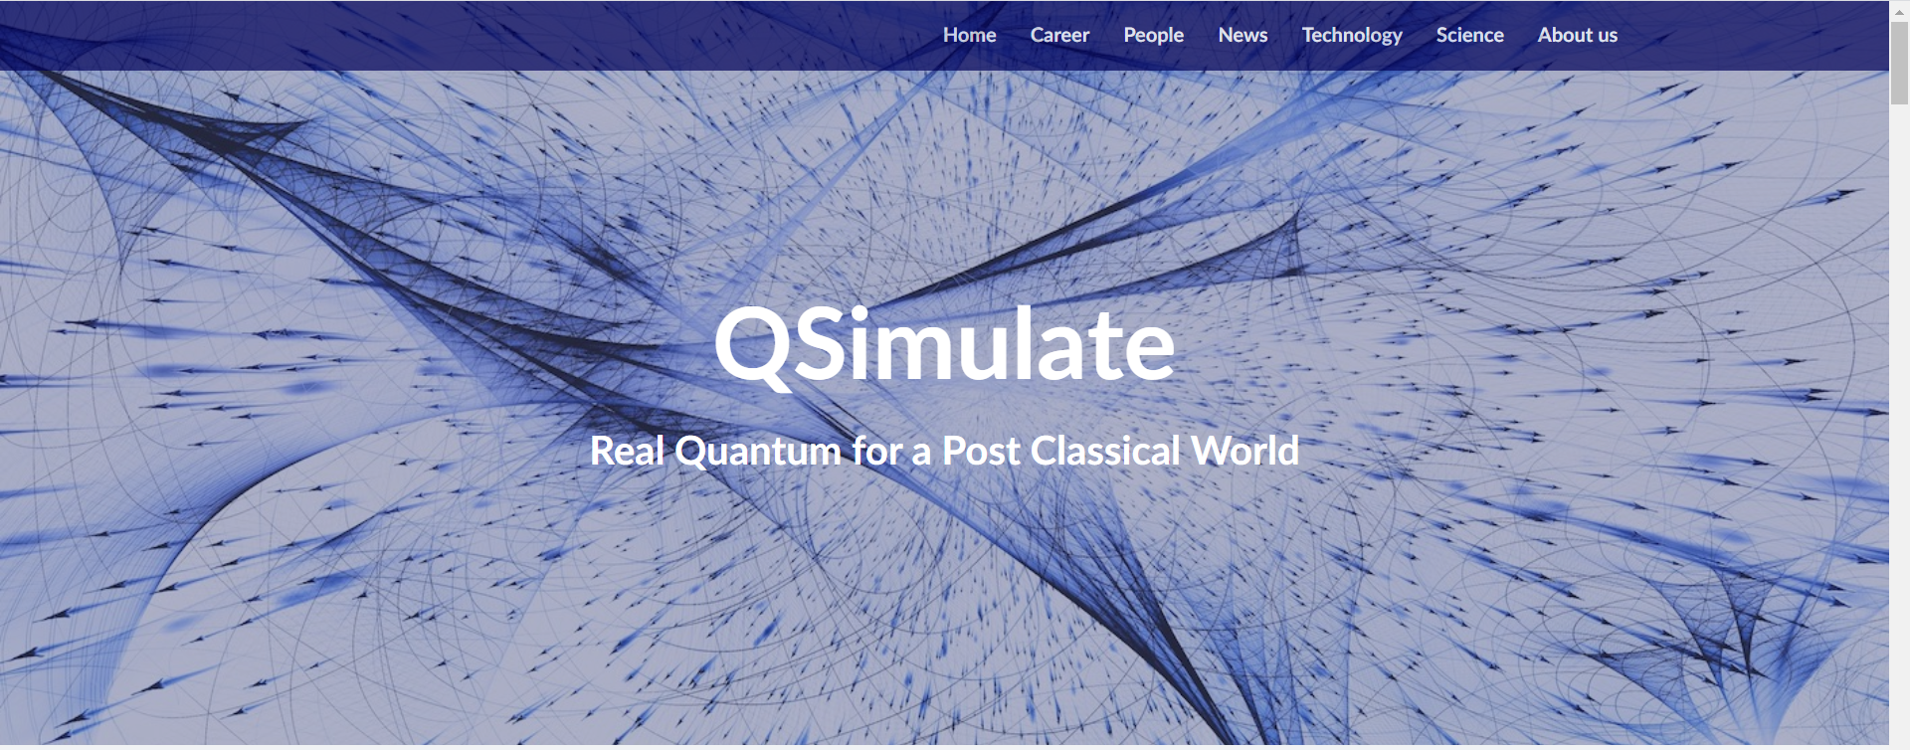
https://qsimulate.com

Slide 19
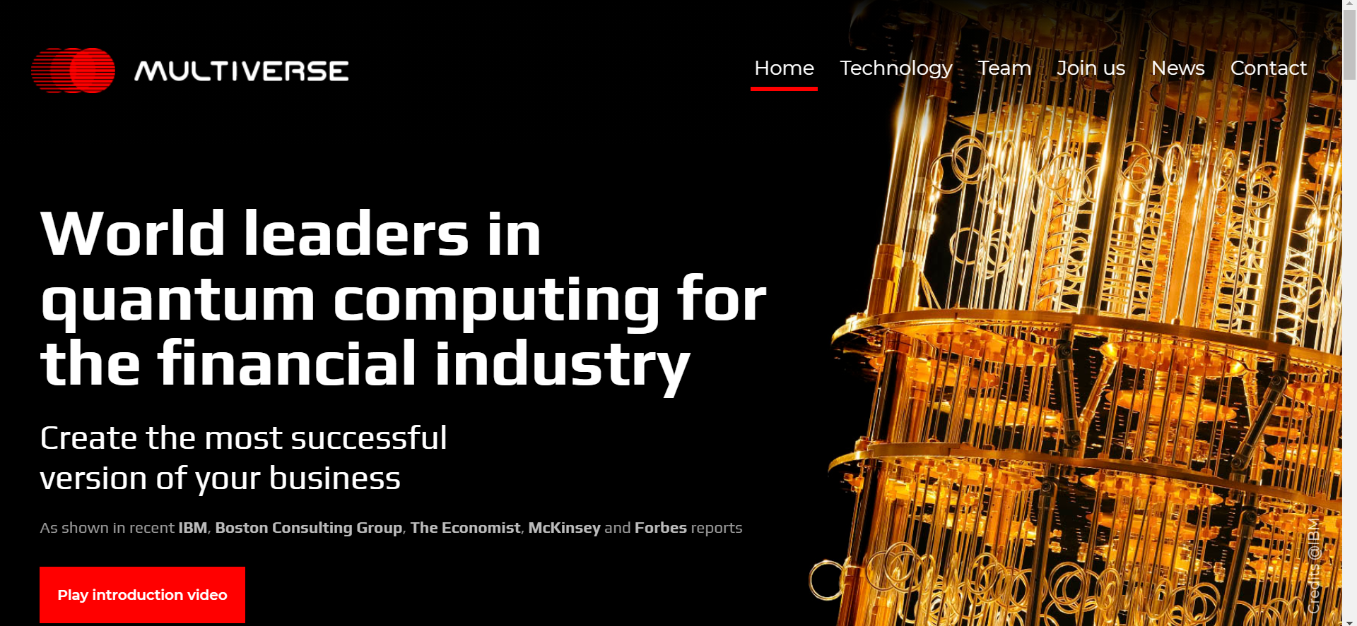
https://www.multiversecomputing.com

Slide 20
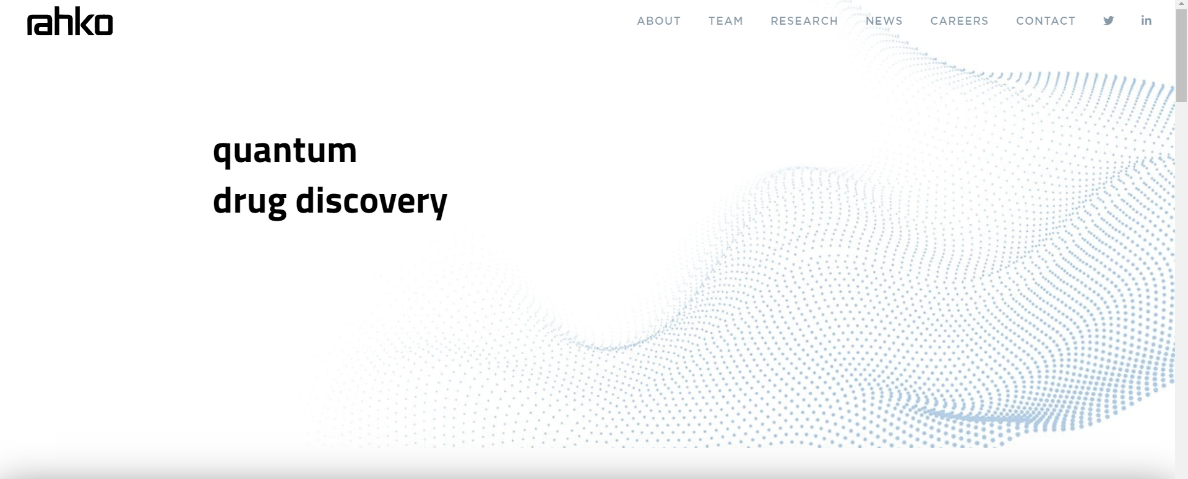
https://rahko.ai

Slide 21
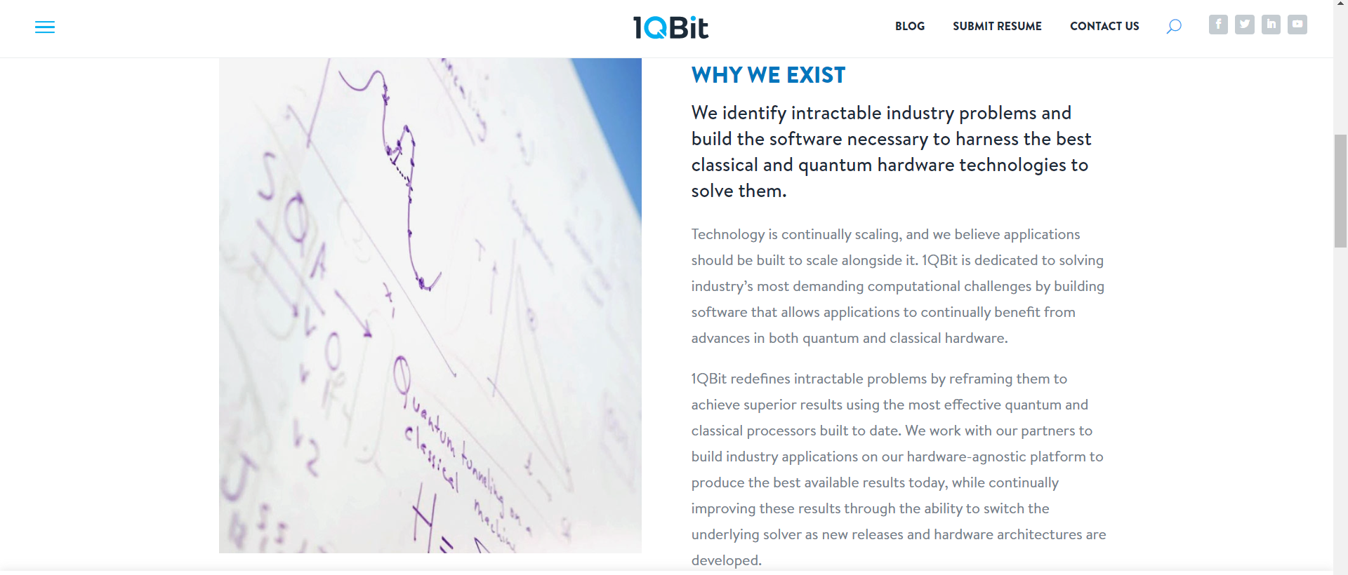
https://1qbit.com

Slide 22
Thank You!

